Slide 1
Loan Default Prediction Using Machine Learning
Objective: Identify key factors influencing loan default risk and develop predictive models
JIRA: Board with To-do, In Progress, Done
Daily Standups: 10-15 min meetings discussing progress and blockers
Agile & Design Thinking: Collaboration, adaptability, continuous feedback

Slide 2
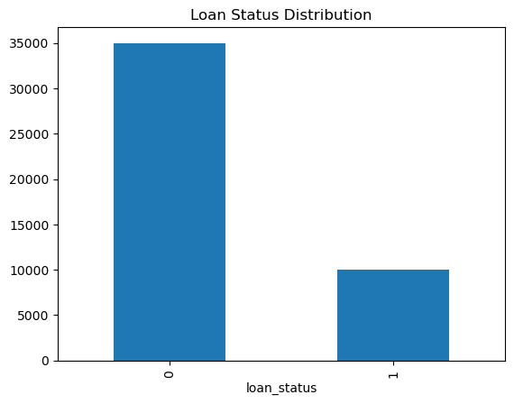
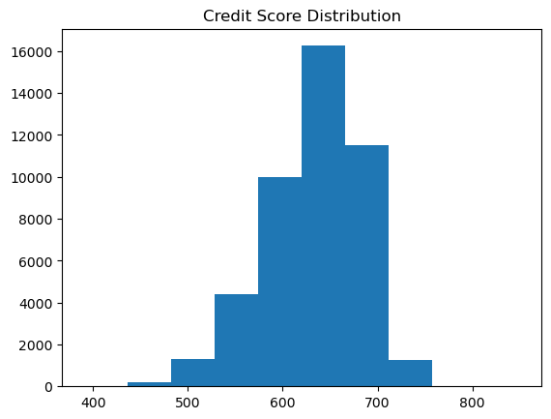
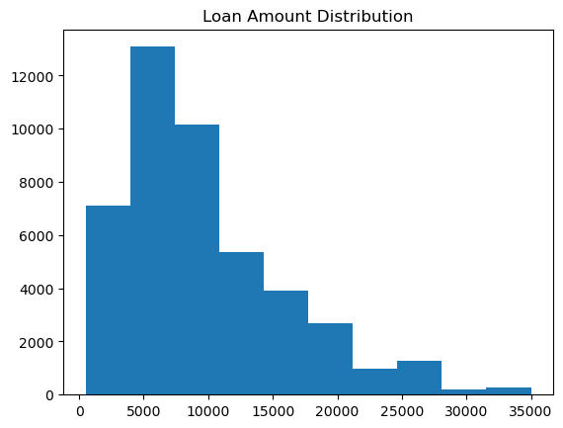
Data Loading, Exploratory Data Analysis (EDA) & Preprocessing
Data loaded from Azure Blob Storage into Microsoft Fabric
EDA revealed financial variables (loan-to-income-ratio, interest rate) have the strongest relationship with default
Missing values handled (median/mode), one-hot encoding, 80/20 train-test split

Slide 3
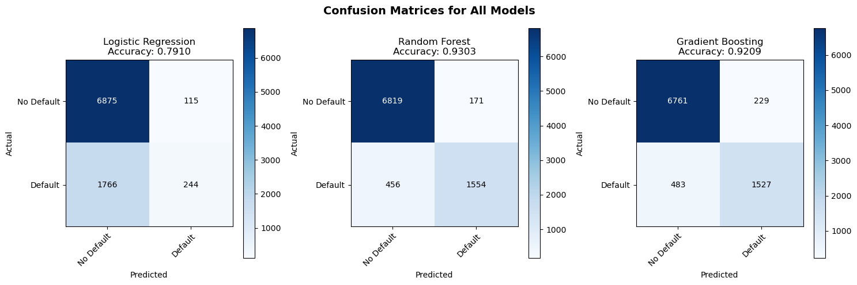
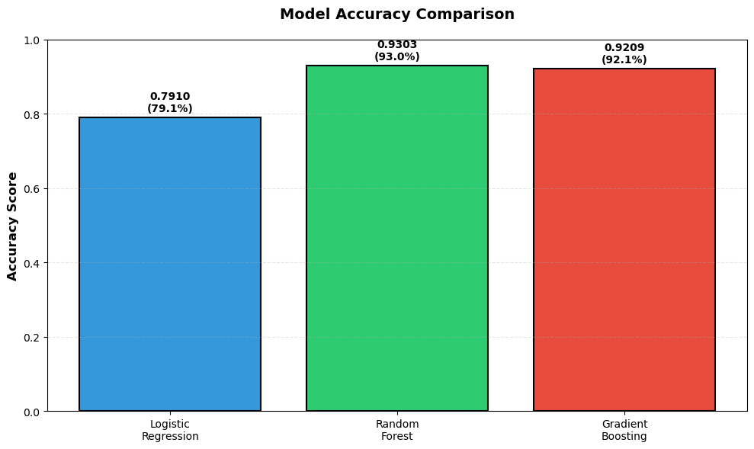
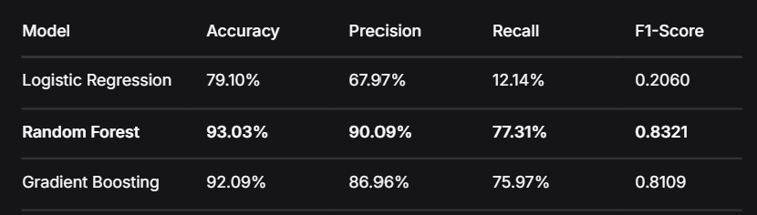
Model Training & Evaluation
Three models trained: Logistic Regression, Random Forest, Gradient Boosting
Models evaluated using Accuracy & Confusion Matrix

Slide 4
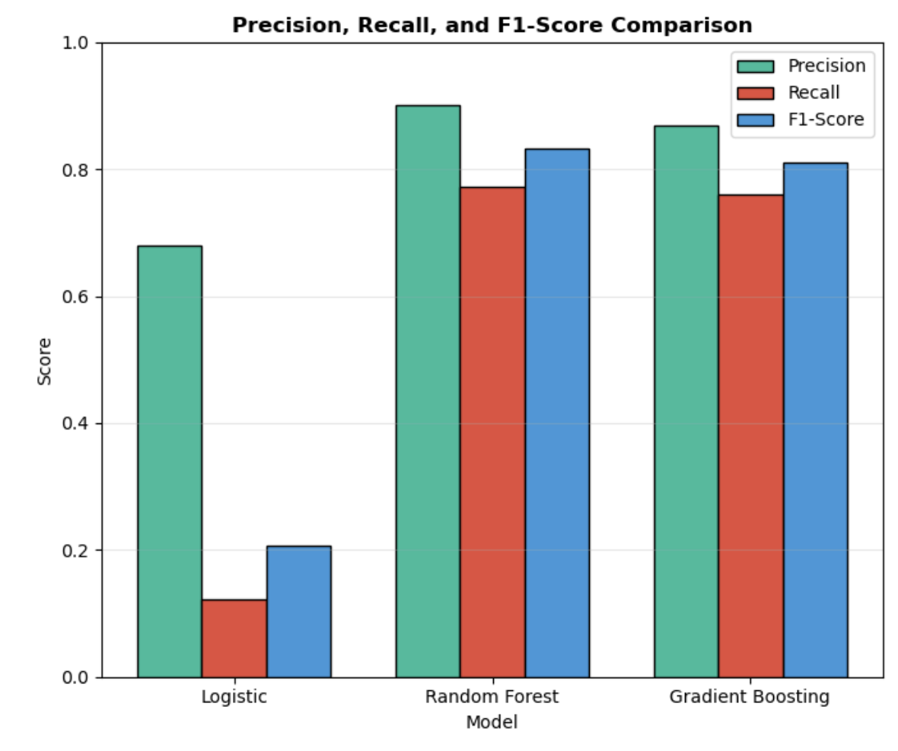
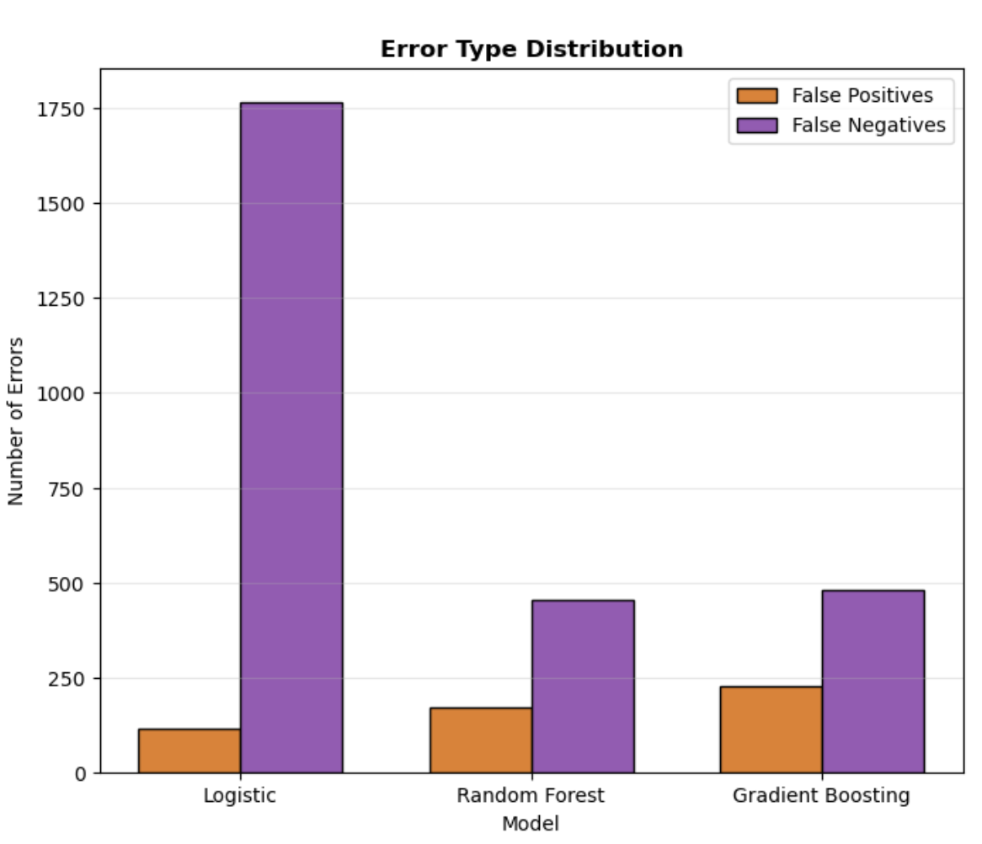
Model Comparison & Best Model Selection
Best model: Random Forest
Error analysis: False Positives vs False Negatives
Why Random Forest is best:
Lowest False Negatives (456) – catches the most actual defaulters
Highest Accuracy (93.03%)
Best F1-Score (0.8321) – best balance of precision and recall.

Slide 5
Lakehouse & Business Conclusion
Recommended model: Random Forest
Results saved to Microsoft Fabric Lakehouse as Delta table
Business insights and recommendations
Key Findings:
Loan default is primarily driven by financial burden (loan-to-income ratio, interest rate)
Traditional indicators like credit score showed limited predictive power
Ensemble methods (Random Forest) outperform simpler models
Recommendations:
Deploy Random Forest for loan approval system
Focus on affordability metrics when assessing loan applications
Retrain model monthly with new loan data

